Slide 1
Key Concepts for Sound Congregational Administration
Presented by American Baptist Churches USA (ABCUSA - Office of the General Secretary)
Important Notice

Slide 2
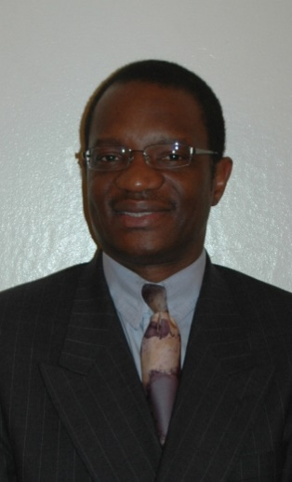
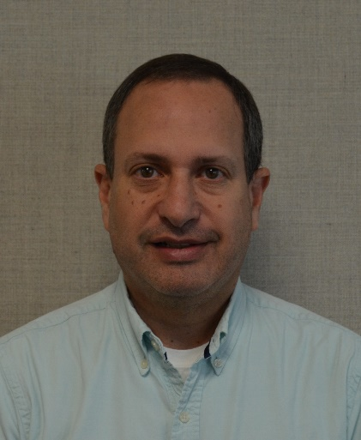
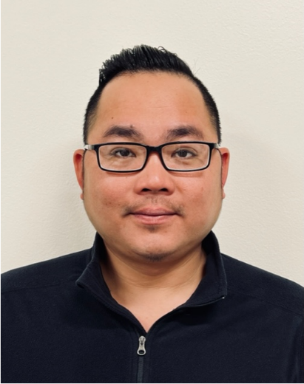
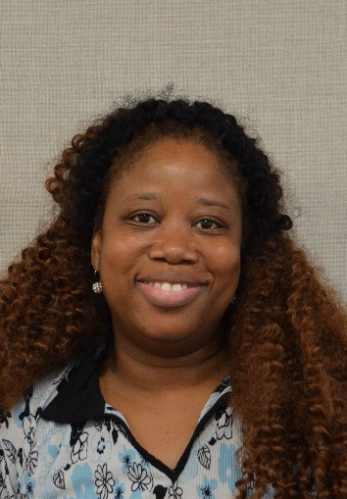
Alan Musoke David Kahn James Tran Genia Clarke-Lemonius
Associate General Secretary Accounting Manager Senior Accountant Mission Fund Accountant
for Finance/CFO/Treasurer

Slide 3
Why is sound congregational administration critical to the pastor’s ministry?
“Whatever you do, do all things
to the glory of God”
I Corinthians 10:31
Chief steward
Reputation of the church must be protected to maintain our witness
Oversight role; don’t need to do it all personally

Slide 4
Why is sound congregational administration critical to the ministry of Board of Trustees and other fiduciaries?*
“Whatever you do, do all things
to the glory of God”
I Corinthians 10:31
Trustees are fiduciaries of church assets
Must maintain a higher standard of care because they are responsible for someone else’s money
Not their own resources
Other church fiduciaries like treasurers

Slide 5
Topics
Local Church Incorporation
Federal Tax Exemption Status
Sales Tax Exemption
Form 990
Church Recognition of Charitable Gifts
Internal Accounting Controls
Basic Financial Oversight

Slide 6
Topics
Other Key Concepts
  Political Support
  Church As Employer
  Risk Management
  Indemnification
  Changing Methods of Giving
  Contributions to ABMS
  ABC Annual Reports
  Leadership Tracking
  Asking for Financial Support

Slide 7
Local Church Incorporation

Slide 8
Local Church Incorporation
Why should the local church be incorporated?
Protects church members from personal liability for actions of the church or other members

Slide 9
Local Church Incorporation
How does a church incorporate?
Generally by preparing, signing and filing Articles (or a Certificate) of Incorporation and adopting Bylaws
Filed with Department of State or Hall of Records for a nominal fee

Slide 10
Local Church Incorporation
Check your state’s legal code, since state to state variances occur.

Slide 11
The Church’s Federal
Tax-Exempt Status as a
501(c)(3) Organization

Slide 12
The Church’s Federal Tax-Exempt Status as a 501(c)(3) Organization
What is a 501(c)(3) organization?
Section 501(c)(3) of the Internal Revenue Code:
A charitable organization with the following criteria:
exclusively for religious or other charitable programs
net earnings may not benefit private individuals
may not intervene in political campaigns
no part of programs illegal or violate fundamental public policy

Slide 13
The Church’s Federal Tax-Exempt Status as a 501(c)(3) Organization
Why is it important?
enables contributions from members to be tax-deductible for the contributor
helps with sales tax exemption
technically, churches are automatically tax exempt
Donors need proof of the church’s 501(c)(3) in order to deduct their charitable contribution on their tax return

Slide 14
The Church’s Federal Tax-Exempt Status as a 501(c)(3) Organization
How do you obtain a record of your church’s
tax exemption? – Option 1
ABCUSA affiliation enables a church to qualify under a blanket federal income tax exemption issued on June 28, 1979.
Churches can apply on their own
Notes:
Can’t grant it; have to ask for it.

Slide 15
The Church’s Federal Tax-Exempt Status as a 501(c)(3) Organization
Call to find out if your church is listed under ABCUSA’s 501(c)(3):
1-800-222-3872, Julie Thomas, ext. 2466 or Iris Cobb, ext. 2280
Yes…request
Request documents—blanket exemption letter and cover letter
Keep them safely with your church’s other vital records
No…apply
Ask for an application
Complete and return the application
ABCUSA will send blanket exemption letter and cover letter

Slide 16
The Church’s Federal Tax-Exempt Status as a 501(c)(3) Organization
How do you obtain a record of your church’s
tax exemption? – Option 2
Obtain independently of ABCUSA if desired
Probably requires legal advice

Slide 17
Federal Tax ID
Church needs federal tax ID to:
Report employee payroll taxes
Obtain state sales tax exemption

Slide 18
State Sales Tax Exemption

Slide 19
State Sales Tax Exemption
Obtain an exemption
Through State Department of Revenue
Periodic renewals necessary
Use only for church related purchases
  (not handled through ABCUSA)

Slide 20
Form 990
What is it?
The standard tax return required for many non-profit, tax exempt organizations

Slide 21
Form 990
Must Churches file a 990?
No, religious organizations are exempt from filing
Honors historic Baptist principle: Separation of Church and State

Slide 22
Church Recognition of Charitable Gifts
Is the church obligated to provide a receipt for gifts?
Yes, for contributions of $250.00 or more
Receipt/acknowledgement includes the following:
  Donor’s name
  Itemized list of each contribution of $250 or more
  Date of each gift

Slide 23
Church Recognition of Charitable Gifts
When must a church provide receipts for gifts under $250?
When the church as a regular process provides a record of gifts (e.g. on a quarterly or annual basis) must be in taxpayer’s hands by mailing date of tax return.

Slide 24
Church Recognition of Charitable Gifts
Receipt/acknowledgement includes the following:
  Statement that “no goods or services other than intangible religious benefits were received in exchange for this gift.”
  Donor must receive by the date his/her tax return is filed

Slide 25
Church Recognition of Charitable Gifts
When is a gift tax deductible?
Gift of cash or other property
Made before close of year for which contribution claimed (based on postmark)
Unconditional and without personal benefit to the contributor
To or for use of the church
Not to exceed amounts allowed by law
Properly substantiated

Slide 26
Church Recognition of Charitable Gifts
When is a gift not tax deductible?
When it is a fee for service
e.g.: church charges a facility fee of $250 for use of Sanctuary for weddings
gift to benefit a specific individual
whenever the church governing board does not have full control and
discretion as to use of donated funds
When goods or services received, only excess paid is deductible

Slide 27
Church Recognition of Charitable Gifts
Once the church receives a restricted donation, what obligation does church incur?
To use the donation as specified:
e.g. America For Christ donation cannot be used to pay heating bill
e.g. Gift to Capital Fund cannot be used to pay pastor’s salary

Slide 28
Internal Accounting Controls

Slide 29
Internal Accounting Controls
“Policies, procedures, methods, and records designed by management to:
  Safeguard assets
  Generate reliable financial information
  Promote operational efficiency
  Ensure adherence to policies”
  The Audit Committee, Page 7, National Center for Nonprofit Boards, Susan Johnson

Slide 30
Internal Accounting Controls
Designed to:
Promote effectiveness and efficiency
Ensure reliability of reports
Ensure compliance with applicable laws and regulations

Slide 31
Internal Accounting Controls
Example: Procedures for ensuring multiple staff involved
Segregation of duties:
  Treasurer for expenses
  Financial Secretary for income

Slide 32
Internal Accounting Controls
Example: Procedures for handling offerings
Offerings always counted immediately
By two or more unrelated persons
Deposit made immediately
Uncounted offerings never go to members’ homes for processing later

Slide 33
Internal Accounting Controls
Should the local church audit its financial statements?
Cost/benefit analysis
Consider risk tolerance of church
Larger churches with multiple staff and large program budgets should audit
Smaller churches might use “trade professional personnel”
Audit off-season for best rates
Consider consequences to church, trustees, staff members if irregularities occur

Slide 34
Basic Financial Oversight

Slide 35
Basic Financial Oversight
Basic Financial Equations
Statement of Financial Position:
Assets – Liabilities = Net Assets (Equity)
Like a snapshot at a moment in time (Also called Balance Sheet)

Slide 36
Basic Financial Oversight
Basic Financial Equations
Statement of Activities:
Revenue – Expenses = Change in Net Assets (Profit/Loss)
Records the flow over time. (Also called Income Statement.)

Slide 37
Basic Financial Oversight
Basic Financial Equations
These two fit together
The Profit or Loss of activities changes the net assets
Get better by practicing!

Slide 38
Basic Financial Oversight
Basic Financial Equations
Types of Net Assets:
Without donor restriction
With donor restriction
Net Assets:
Categorized based on donor’s intent

Slide 39
Basic Financial Oversight
Statement of Financial Position
Snapshot at a given moment

Slide 40
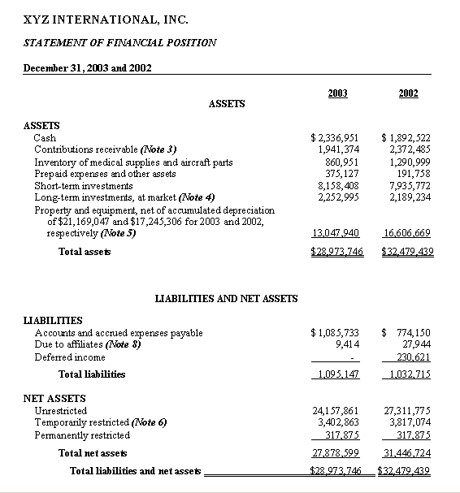
Basic Financial Oversight
Statement of Financial Position
SAMPLE

Slide 41
Basic Financial Oversight
Statement of Activities
Captures the in’s and out’s of financial activity.
Captures the flow of finance in organization.

Slide 42
Basic Financial Oversight
The Church’s Budget
Every church needs a written document
Presented by Trustees (or other designated church board)
Adopted by congregation in business meeting

Slide 43
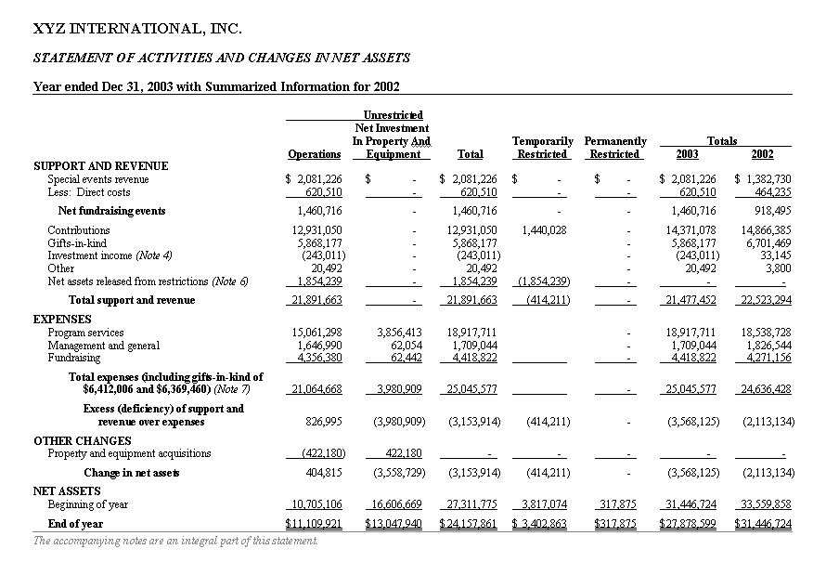
Basic Financial Oversight
Statement of Activities SAMPLE

Slide 44
Basic Financial Oversight
Every church needs to ask for members’ support
Annual Process
Ask directly; don’t hint
Stewardship critical for every disciple

Slide 45
Other Key Concepts

Slide 46
Changing Environment
What is the Environment in which Churches Operate?
More scrutiny
IRS is focusing on nonprofits.
Since 1994, new accounting standards require nonprofits to emulate For Profits in how they present financial statements.
Sarbanes Oxley Legislation (legislation to tighten accounting controls after the Enron scandal.) may also affect
Therefore, Non Profit Oversight is increasingly important.

Slide 47
Changing Environment
What is the Environment in which Churches Operate?
Municipalities and cities are now scrutinizing more closely the activities of nonprofits. For example, many nonprofits have been targeted and have lost their property tax exemption due to unrelated activities (e.g. renting out to for-profit organizations).

Slide 48
Political Support
How can churches support the political process?
By providing voter education
By advising all to vote
By examining theological issues of responsibility as citizens
By providing a forum for all candidates in an election
Note: Churches could threaten their IRS 501(c)(3) status if they support a particular candidate or political party or give only one candidate or political party access to congregation

Slide 49
Church As Employer
Ordained persons are treated differently
Housing allowance available by vote of appropriate church board
Ministers are self-employed for social security purposes so that churches do not withhold
Social security allowance possible
MMBB is available to answer your questions at 1-800-986-6222

Slide 50
Church As Employer
Church must file tax reports as employer
Federal Form 941
State Form
Form W-2 by January 31 of next year
Form W-3 by February 28 of next year

Slide 51
Church As Employer
Churches should provide Workers Compensation Insurance

Slide 52
Risk Management
Consider Church’s Risk Tolerance
Assess Church’s Risk

Slide 53
Risk Management Assessment
Are staff/volunteers trained for emergency management?
Does the church have written policies and procedures?
How are drivers qualified to drive church owned vehicles?
Do workers take universal precautions?
Are background checks performed on volunteers and staff?

Slide 54
Risk Management
Liability Insurance
Require Certificate of Insurance if/when other groups use church facilities
Directors and Officers
Property Insurance
Replacement Costs

Slide 55
Indemnification Further Protects Officers
What is indemnification?
Legal exemption from penalties
Granted to officers and other persons

Slide 56
Indemnification Further Protects Officers
“The Church shall indemnify authorized representatives of the Church as provided in the [applicable state statute] and as may be provided from time to time in the Bylaws of the Church.”

Slide 57
Indemnification Further Protects Officers
“Subject to the limitations set out in these Bylaws, the church shall indemnify any director or officer who was, is, or is threatened to be made a party to a completed, pending or threatened action or proceeding from any liability arising from the director’s or officer’s official capacity with the Church.”

Slide 58
Newer Methods of Giving
Donors find these very friendly methods of giving
Electronic transfer of funds (EFT) can make regular payments automatically
Credit Card Giving
Online giving
www.abc-usa.org “Give Online” can receive gifts 24/7

Slide 59
American Baptist Mission Support (ABMS)

Slide 60
What is ABMS?
The mission giving of a church or individual to ministries at the regional, national or international level of American Baptist Churches

Slide 61
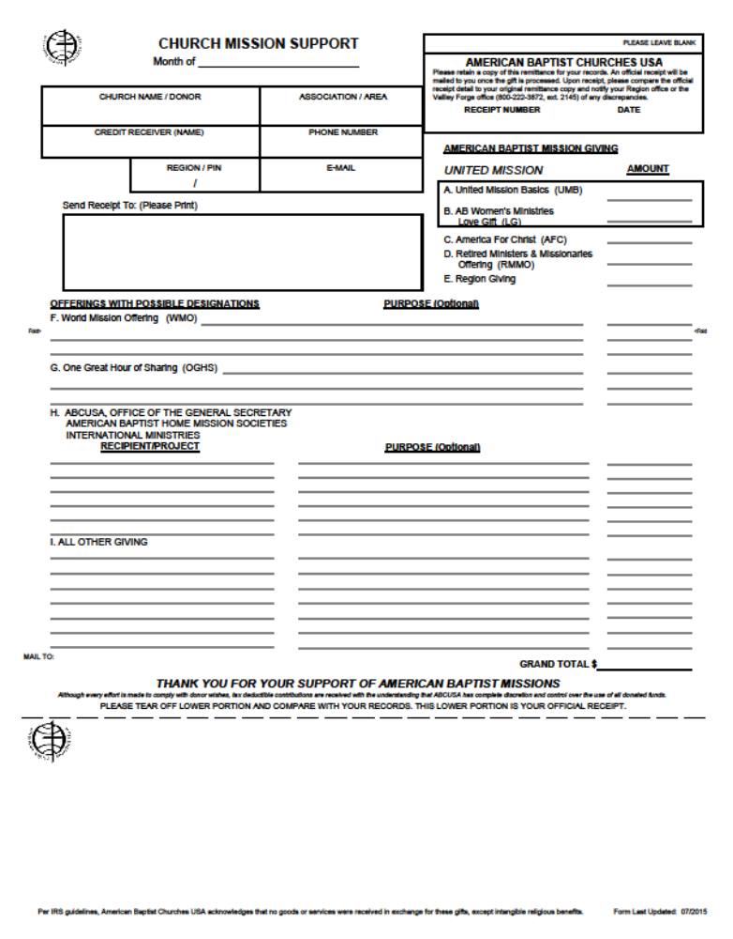
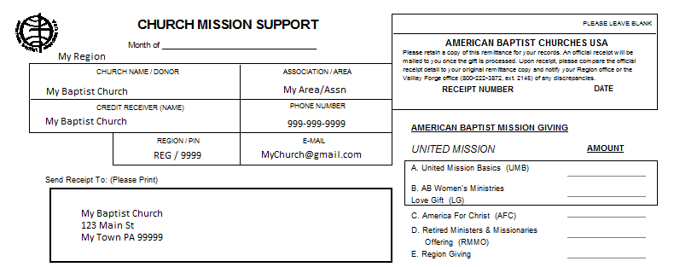
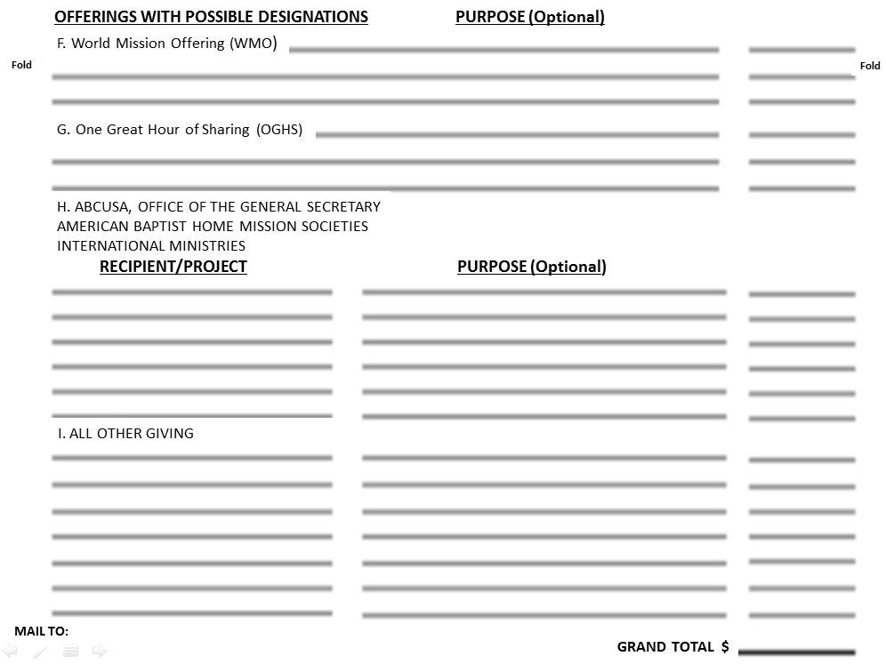
Church Mission Support Form
Redesigned

Slide 62
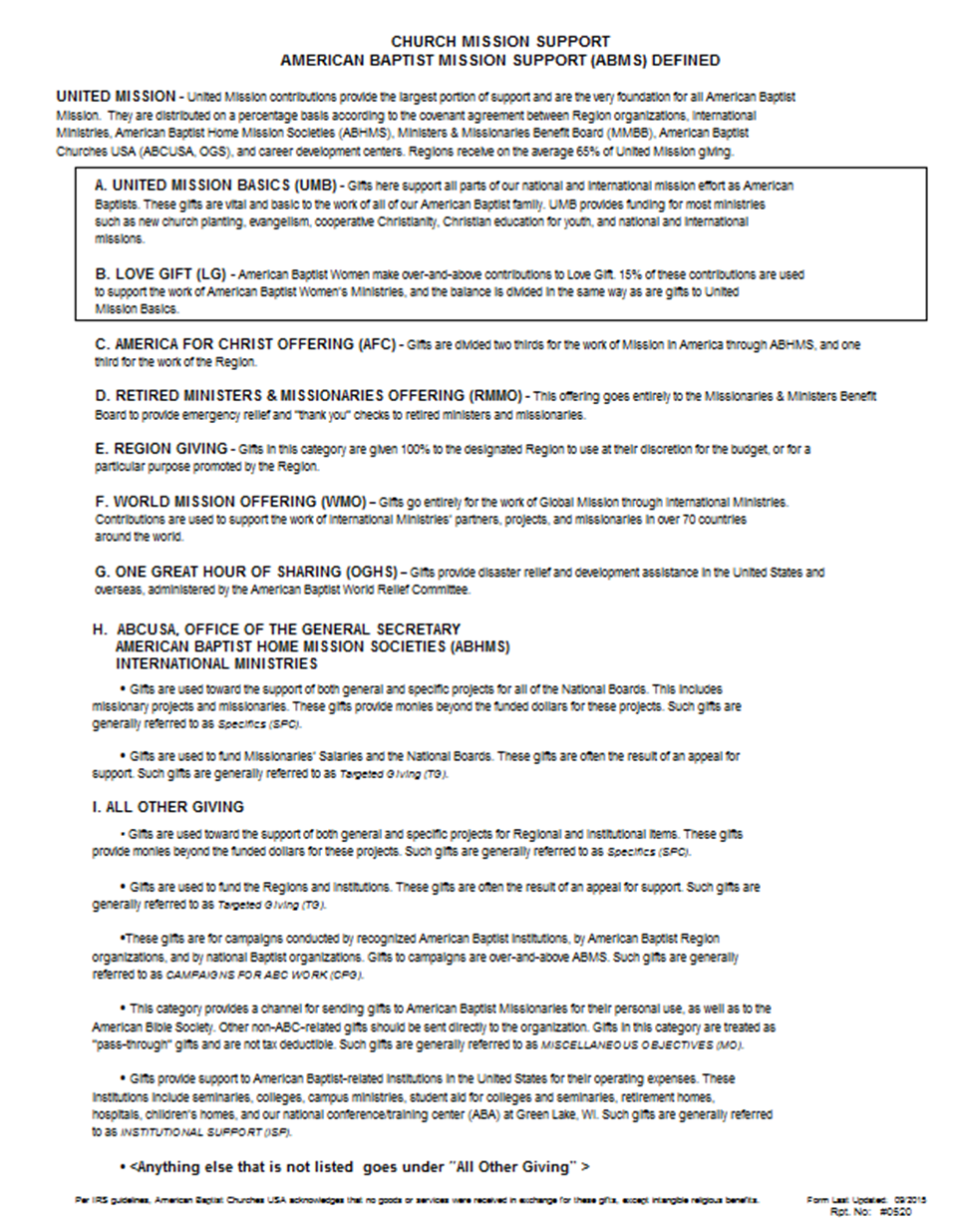
New Form Definitions Page
(CG).

Slide 63
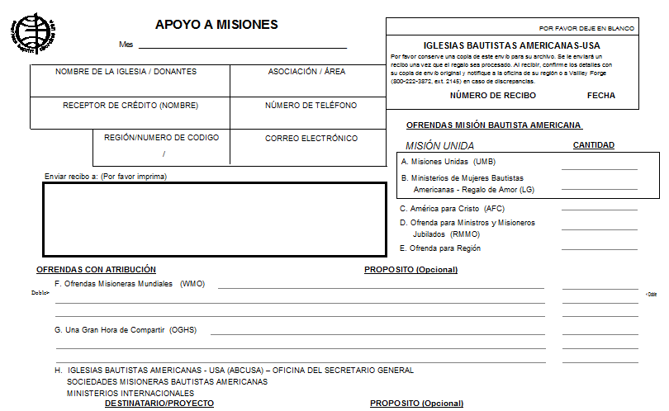
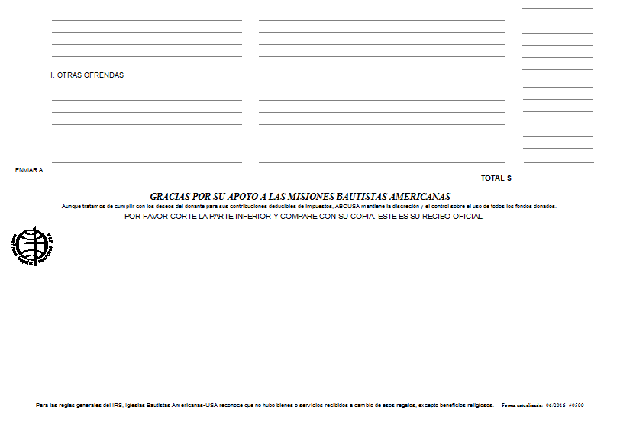
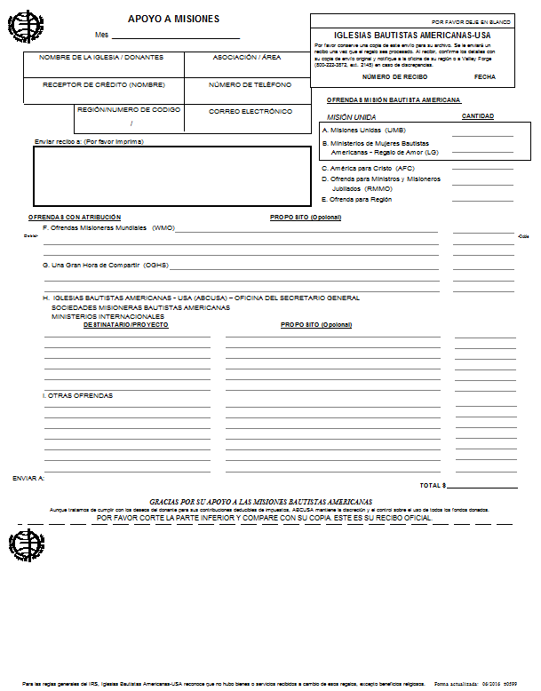
Church Mission Support Form
In Spanish!

Slide 64
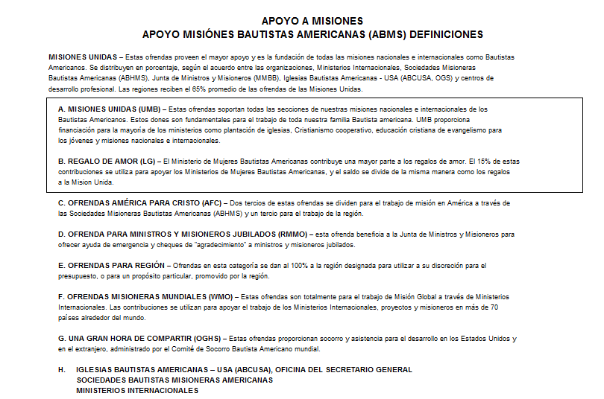
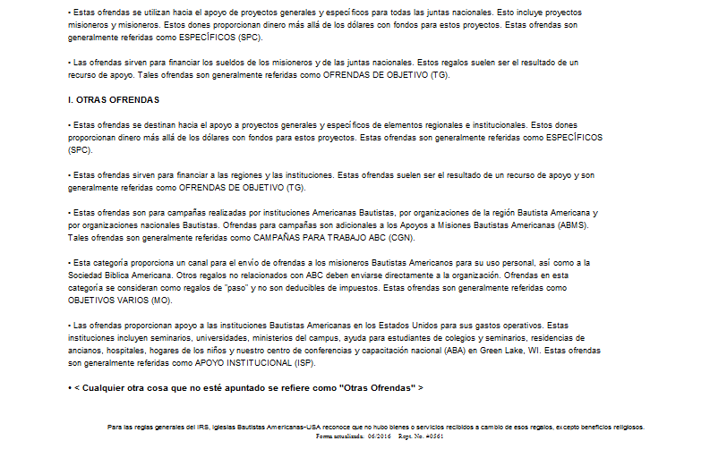
New Form Definitions Page
In Spanish!

Slide 65
How much mission giving is appropriate?
Contributions to ABMS
One rule of thumb: A tithe, 10% of your church’s budget
Your regional office can help your church decide – ask your region for help

Slide 66
ABC Annual Report
Is completed every year
Preserves data on baptisms, membership, attendance and other denominational statistics
Is used to calculate delegate count for Biennial Mission Summit
Provides proof of ABC cooperating churches
Is used for mailings and Find a Church
Needs to be made a priority!

Slide 67
Leadership Tracking— Professional Registry
Keeps your ministerial standing up-to-date
Is monitored/entered by the Regions
When moving to a new Region, contact them right away
Non-ABC ordination can be ABC-recognized through the Region

Slide 68
Asking for Financial Support
Why do we have a hard time asking for financial support? American Baptists have a fear of talking about money. We try to be people of God’s Word, and “ask” is an important biblical word.

Slide 69
Asking for Financial Support
The word “ask” is mentioned 157 times in scripture.
57 of those times relate to help in ministry.
We ask God. God asks us. We ask others. Others ask us. As a result, people give to ministry.

Slide 70
Asking for Financial Support
Consider the following scripture verses:
Moses asked. (Exodus 36)
David asked. (1 Chronicles 29)
Malachi asked. (Malachi 3:3)
Jesus asked. (Luke 6:38)
Paul asked. (2 Corinthians 8-9)

Slide 71
Asking for Financial Support
Could it be any clearer?
“Ask and it will be given you.” (Matthew 7:7)
“You do not have because you do not ask.” (James 4:2)
“Now to him who by the power at work within us is able to do far more abundantly than all that we ask or think..” (Ephesians 3:20)

Slide 72
Asking for Financial Support
Need Resources?
www.generousdisciples.org

Slide 73
Questions?
We welcome your questions and suggestions about this presentation. Please contact one of the following persons to provide your feedback.
(800)ABC-3USA (222-3872)
Genia Clarke-Lemonius, Mission Fund Manager
ext. 2145, genia.clarke@abc-usa.org
David Kahn, Accounting Manager
ext. 2332, david.kahn@abc-usa.org

Slide 74
Questions?
Continued:
James Tran, Senior Accountant
ext. 2161, james.tran@abc-usa.org
Alan Musoke,
Associate General Secretary for Finance/CFO/Treasurer
ext. 2291, alan.musoke@abc-usa.org

Slide 75
This presentation is made possible by your support of United Mission

Slide 76
“SOUND CONGREGATIONAL ADMINISTRATION” LEGAL DISCLAIMER
“SOUND CONGREGATIONAL ADMINISTRATION” IS INTENDED TO CONVEY GENERAL INFORMATION AND SHOULD NOT BE RELIED UPON AS A SUBSTITUTE FOR LEGAL, ACCOUNTING, TAX, FINANCIAL OR OTHER PROFESSIONAL ADVICE AND SERVICES. THE INFORMATION PROVIDED IN THIS SITE IS PROVIDED WITH THE UNDERSTANDING THAT ABCUSA IS NOT HEREIN ENGAGED IN RENDERING ANY SUCH ADVICE OR SERVICES. ALL THE MATERIALS IN THIS SITE ARE PROVIDED “AS IS” WITH NO GUARANTEE OF COMPLETENESS, ACCURACY, TIMELINESS OR OF THE RESULTS OBTAINED FROM THE USE OF THIS INFORMATION, AND WITHOUT WARRANTIES OF ANY KIND EITHER EXPRESS OR IMPLIED, INCLUDING BUT NOT LIMITED TO WARRANTIES OF PERFORMANCE OR THE IMPLIED WARRANTIES OF MERCHANTABILITY OF FITNESS FOR A PARTICULAR PURPOSE. ABCUSA DOES NOT WARRANT THAT THE CONTENT OF THIS SITE IS ERROR-FREE OR OMISSION-FREE OR THAT DEFECTS WILL BE CORRECTED. ABCUSA DOES NOT WARRANT OR MAKE ANY REPRESENTATIONS REGARDING THE USE OR THE RESULTS OF THE USE OF THE MATERIALS IN THIS SITE.
ABCUSA DOES NOT WARRANT THAT THIS SITE OR THE SERVER THAT MAKES IT AVAILABLE ARE FREE OF VIRUS OR OTHER HARMFUL COMPONENTS. YOU ASSUME THE ENTIRE COST OF ALL NECESSARY SERVICING, REPAIR OR CORRECTION RESULTING FROM ANY USE OF THIS SITE.
IN NO EVENT WILL ABCUSA BE LIABLE FOR ANY DAMAGES WHATSOEVER, INCLUDING BUT NOT LIMITED TO TORT, DIRECT, INDIRECT, SPECIAL, INCIDENTAL OR CONSEQUENTIAL DAMAGES OF ANY KIND.
Back

